Slide 1
Insert LOGO
Barret Hodgson
Remote Data
Center
A simple data center for Barret Hodgson university and pharmaceutical
limited
ALLPPT.com _ Free PowerPoint Templates, Diagrams and Charts

Slide 2
Data Center
A data center or data centre is a building, a dedicated space within a building, or a group of buildings used to house computer systems and associated components, such as telecommunications and storage systems.
We will using this to store highly confidential and important data for both the university and company.

Slide 3
Why at a remote location
Cost efficient.
More data security.
Ensure back up in case of any emergency like natural disaster or fire.

Slide 4
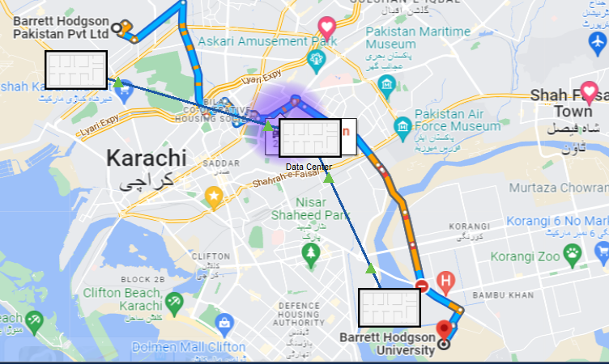
Physical map of locations

Slide 5
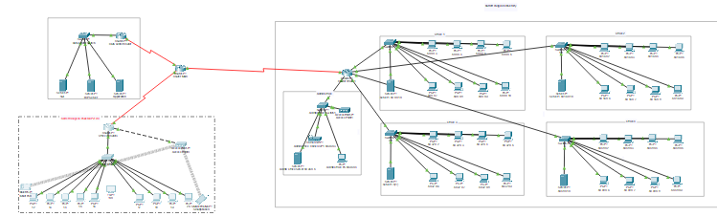
Logical Map

Slide 6
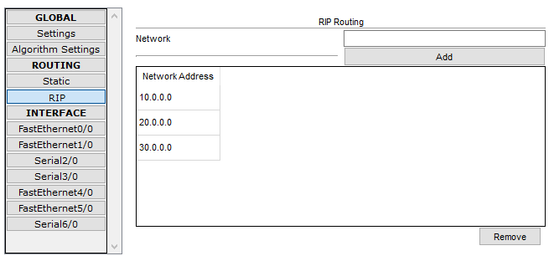
How connectivity is achived?
Multiple networks working simultaniously at main aggrigation router

Slide 7
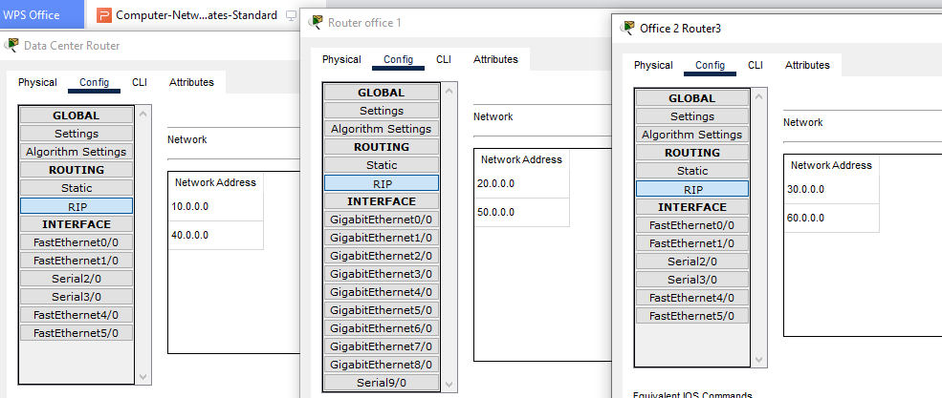

Slide 8
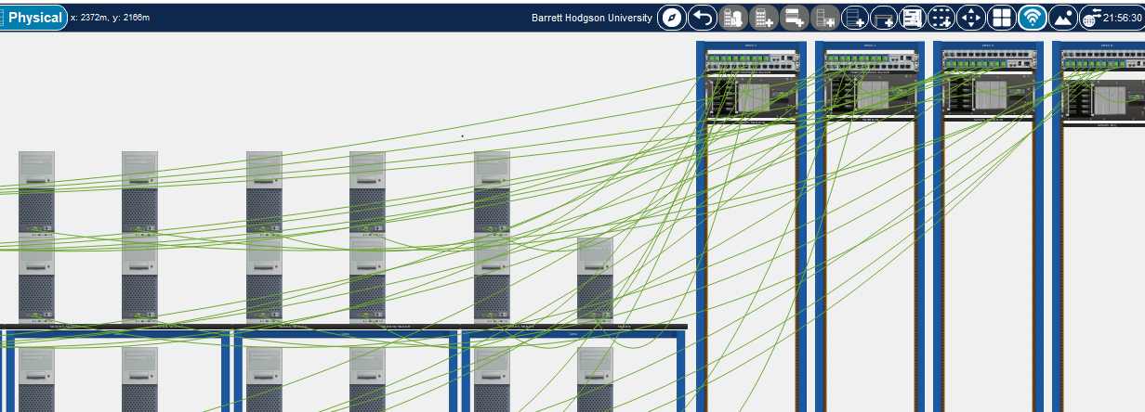
Barret Hodgson University

Slide 9
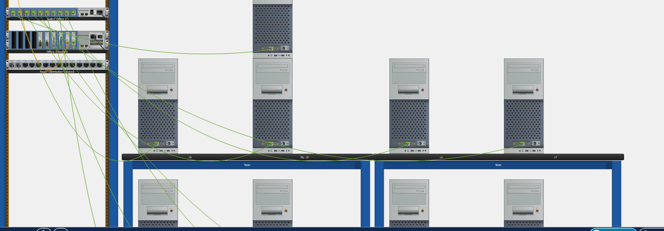
Barret Hodgson Pvt

Slide 10


